Slide 1
PSF Propagation Methods
Is using the AOSim2 AOAtmo class a valid approximation?

Slide 2
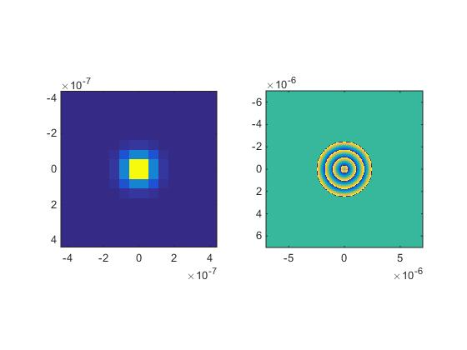
The Spherical Wave
Matlab was used to generate a spherical wave
Mathematical Form:
U0 = (A0 .* exp(1i*k.*R))./(4*pi.*R);
U0 was then scaled by a thin Gaussian to avoid numerical complications.
Picture to right shows the wave used in the Propagation Method
(left is amplitude, right is phase)

Slide 3
The Methods
AOAtmo System Model
(Atmo Method)
Propagate from Ground to Telescope
(Propagation Method)
3 Phase Screens
Altitudes of 10, 5000, and 9990 meters
C_{n}² values from Hufnagel-Valley Model
Screens are given thickness, C_{n}² is considered constant over the layer
Beacon as source
The big assumption here is that no propagation is needed
No scintillation effects
Treated as single, combined-effect phase screen, computing the OPL from beacon to pupil
3 Phase Screens with the same statistics as Atmo Model (but different realizations)
Screens are considered collapsed to 1 meter thickness at the same altitudes as the Atmo Model
A spherical wave is propagated from ground up through screens to camera

Slide 4
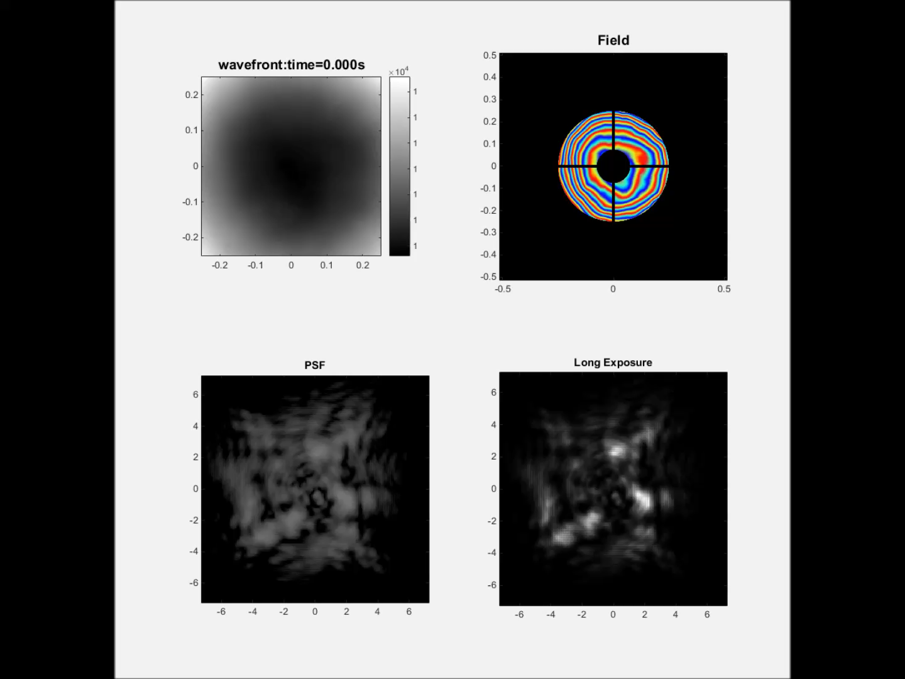
The Atmo Model

Slide 5
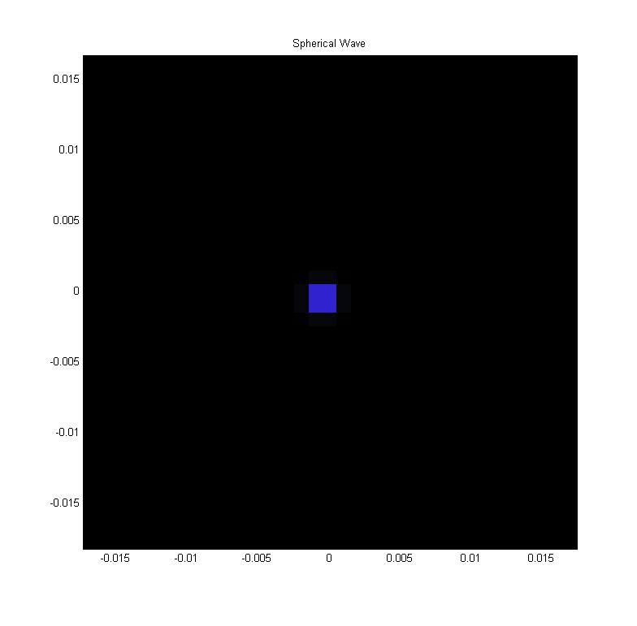
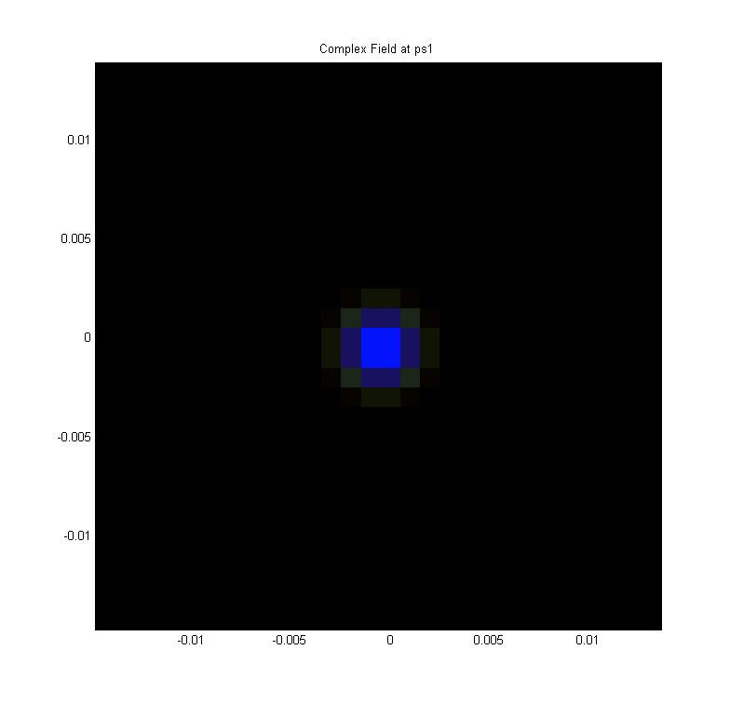
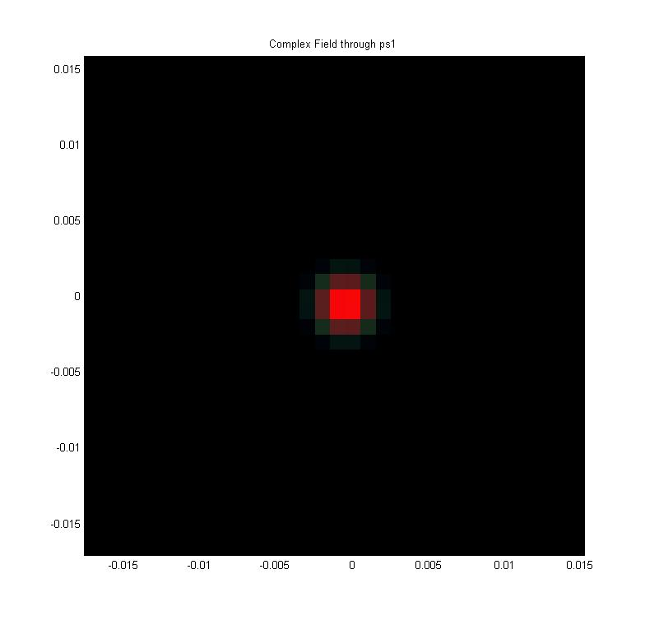
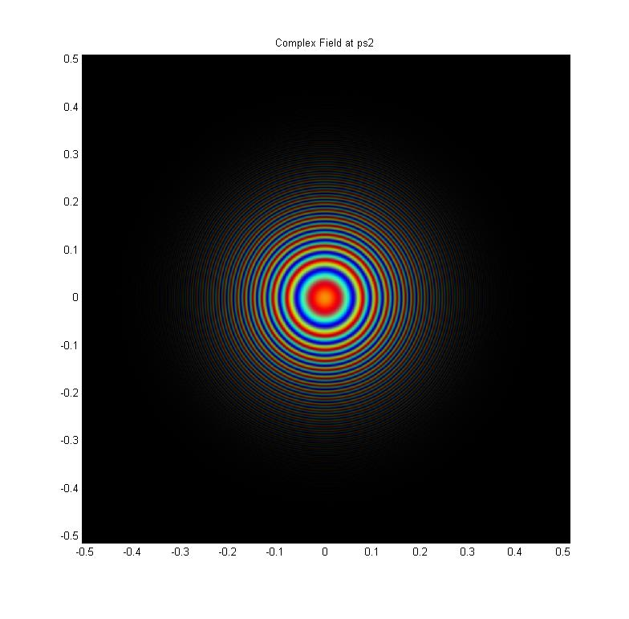

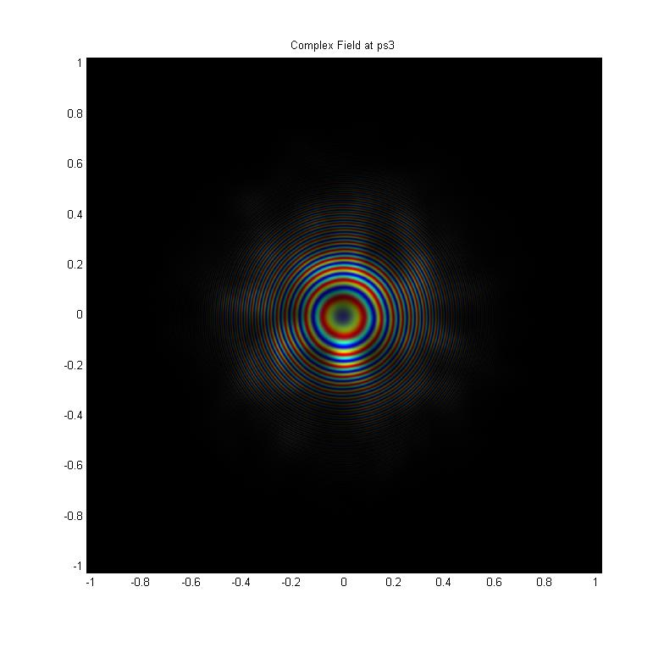

Stepping Through the Propagation
Step 2: Propagate Point Source to first Phase Screen---z = 10 meters
Step 1: Point Source. This is the spherical wave shown earlier, just plotted differently, and significantly zero-padded to avoid aliasing as this process unfolds
Step 3: Go through Phase
Screen 1
Step 4: Propagate to second
Phase Screen---z = 5000 meters
Step 5: Go through Phase
Screen 2
Step 6: Propagate to third
Phase Screen---z = 9990 meters
Step 7: Go through Phase
Screen 3

Slide 6
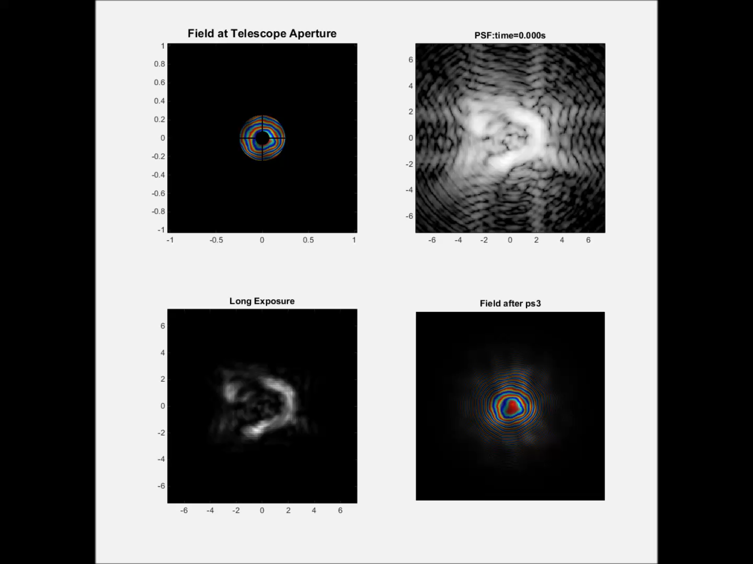
Now running the Simulation

Slide 7
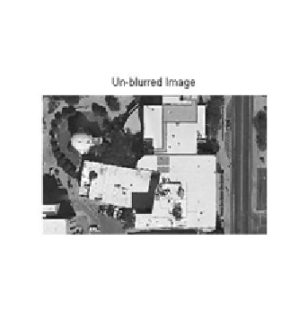
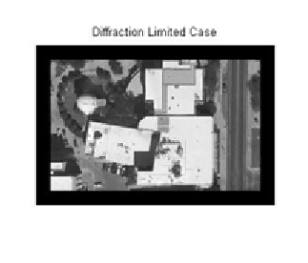
Performance Metric
Compare images blurred by the computed PSFs of the models
While not done as a true image simulation, the turbulence effects can be seen and compared
Seen to the right is the original image, and the diffraction limited image

Slide 8
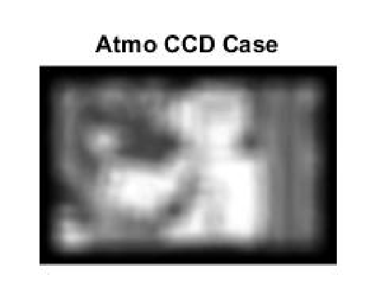
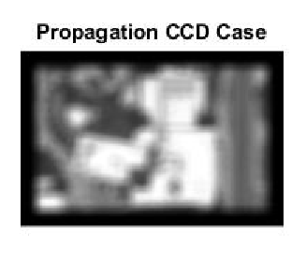
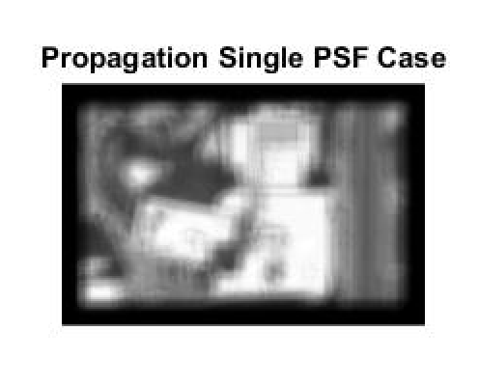
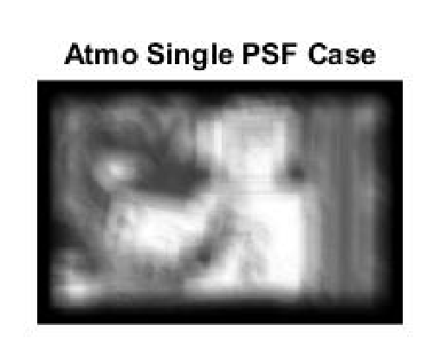
Compare the Models

Slide 9
Conclusions
As seen in those pictures, the blurring from the turbulence is significant, especially if trying to resolve letters on a license plate
Second, two conclusions can be drawn from looking at the blurred images and seeing the Propagation Method returns a “better” image:
1) The Atmo method makes assumptions that make the computation of the PSF less accurate in ways other than not including scintillation effects
2) There is a numerical problem in the simulation
In general, a trade off would exist for these methods. The Propagation Method returns a better looking image, but takes much longer to run than using the AOAtmo class.
It seems that the time saved outweighs the slight improvement in results
An AO system of some sort would be needed to accomplish the resolution we hope to achieve

Slide 10
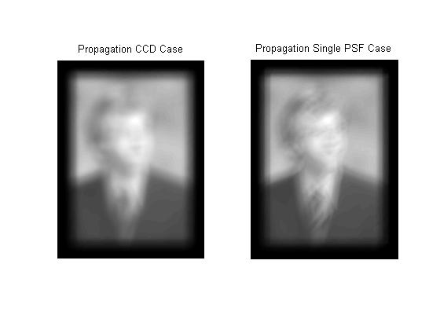
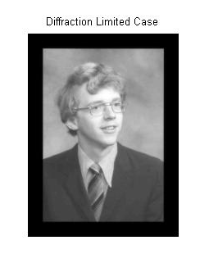
The Audience Participation Section
Can we bring you from here……
To here.

